Slide 1
Stair climbing wheel chair

Slide 2
Why implementing this project ?
The purpose of implementation of this project is to reduce the cost of an electric wheel chair and also to make it suitable for stair climbing.
This project will make all the needed people able to buy this because of its cheap price.
In todays market scenarios only the rich could afford an electric wheel chair that can climb stairs. Even if it could it consume a lot of power or it needs its own path.
This is suitable for long time running because of the type of motor.

Slide 3
What is the solution?
This is a basic alternative wheel chair equipped with electric and electronic gear and few design changes.
This wheel chair has a specified wheel that can be used to climb stairs with no ease and also be used for normal purposes.
This idea was found from the legs of a quadruped.
The wheel looks like a fan and at the end like a hoe.

Slide 4
Materials Used for the prototype
2*Motors, 3* wheels .
Arduino motor driver, gait shield, starter shield.
2*batteries.
Accelerometer.
1* servo motor.
Ultrasonic sensor.
LCD Screen.
Chassis and needed clamps.
IR remote(used as an alternative of joystick)

Slide 5
 |  |  |  | Designed for: |  |  | Designed by: |  | Date: |  | Version:
Business Model Canvas
Key Partners | Key Activities |  | Value Propositions |  |  |  | Customer Relationships |  | Customer Segments
Sprobotic works, Allen Bradley, VMS Careline – wheel chair, | Setting up of machines that install the wheel chair. Testing phase Creating and filling the contents of the database. Transportation. |  | Factory setup. Management of the employees. |  |  |  | We provide services for the customer and create products directly for use by the customers. The customers must initially share their needs in order to make it useable by them. |  | Our customers are mostly common people who wants to have a comfortable multi purpose wheel chair. The product will be almost exclusively available to common people, and government enterprises.
 | Key Resources |  |  |  |  |  | Channels
 | 2*Motors, 2* wheels, Arduino motor drive, gait shield, starter shield, 2*batteries, Accelerometer , 2* servo motors, Ultrasonic sensor, LCD Screen, Chassis and clamps. |  |  |  |  |  | The items are transported through land vehicles mostly trucks as the product is not bulky and is lightweight. The coverage of market of this product will be limited and hence land transportation will be sufficient
Cost Structure |  |  |  |  | Revenue Streams
Wheel chair: 12,000rs set up cost: 2,000rs Labour, Transportation and set up charges:15,000rs (The base charge for the product includes the package of qc verified wheel chair with all the items, transportation and the set up charge are included. This price comes to the estimated amount of 15,000rs. This is the starting price and additional features can be added.) |  |  |  |  | The total cost of the product including the installation is estimated to be about 15,000rs The company earns a profit of 1,000rs per unit product sold. The details of cost estimation is given in the following slides.(The rate for each installation may vary as requirement will be different for each customer). An initial payment has to be given to the company via bank in order to order the necessary equipment. The initial fee decided will e based off of the total payment.

Slide 6
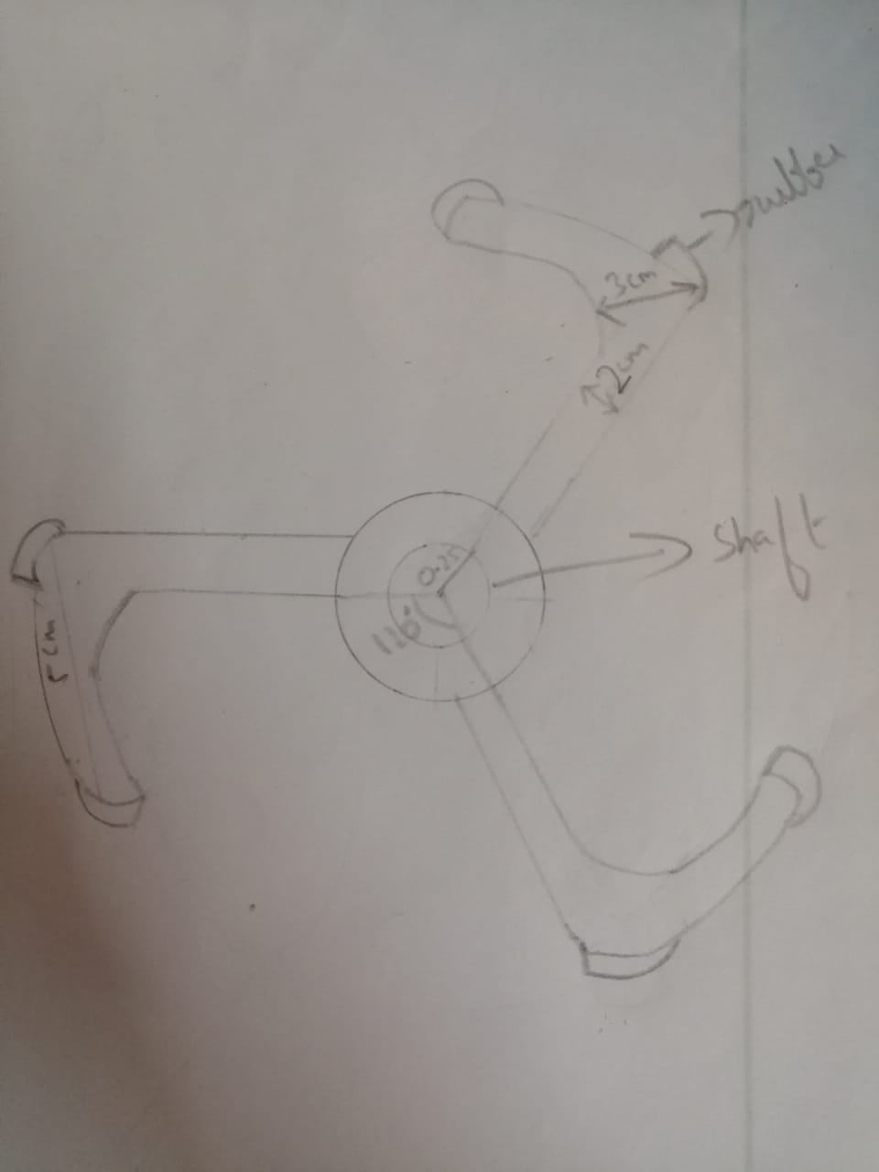
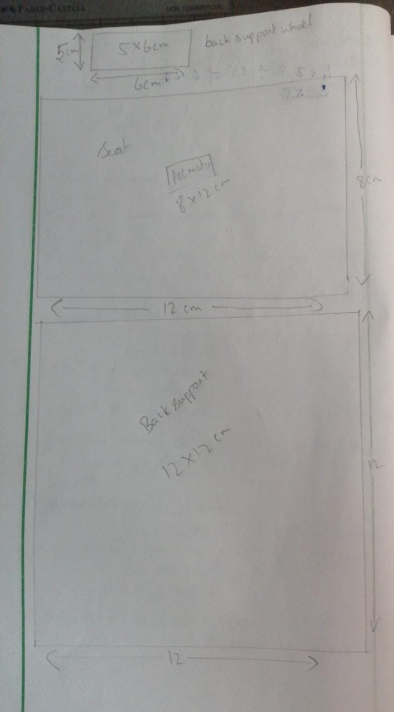
Diagram for wheel and chassis

Slide 7
Arduino program
#include <VarSpeedServo.h>
#include<SPIRremote.h>
#include <LiquidCrystal.h>
LiquidCrystal lcd(13, 12, 8, 7, 4, 2);
SPIRremote remote(9);
int IRValue;
int lmt1 = 5;
int lmt2 = 6;
int rmt1 = 11;
int rmt2 = 10;

Slide 8
//Variables needed for servo control
int S; //variable to create a formulae that is used to make our servo automatic
int az; //Mapping Z axis
int ay;//Mapping Y axis
int ax; //Mapping X axis
int zm=265; //Minimum value of Z axis that has been recorded
int zx=400; // Max value of z axis that has been recorded
double z; //double-precision floating point number
VarSpeedServo l1;
void setup()
{
//setting up display
lcd.begin(16, 2);
//attaching motors
remote.begin();
pinMode(lmt1, OUTPUT);
pinMode(lmt2, OUTPUT);
pinMode(rmt1, OUTPUT);
pinMode(rmt2, OUTPUT);

Slide 9
//attaching accelerometer
pinMode(A0, INPUT);
l1.attach(10); }
void loop()
{
//program for seat to adjust itself to make it comfortable to move in staircase.
az = analogRead(A0);
ay = analogRead(A1);
ax = analogRead(A2);
int za = map(az,zm,zx,-90,90);
int xa = map(ax,zm,zx,-90,90);
int ya = map(ay,zm,zx,-90,90);
z= RAD_TO_DEG * (atan2(-ya, -xa)+PI);
S = map(z, 255, 300, 10,50)
l1.write(S);
delay(1000);

Slide 10
delay(400);
//Program starts for wheelchairs movement
IRValue=remote.receive();
if(IRValue==1)
{
forward();
lcd.setCursor(0, 0);
lcd.print("Moving ");
lcd.setCursor(0, 1);
lcd.print("Forward ");
}
if(IRValue==2)
{
backward();
lcd.setCursor(0, 0);
lcd.print("Moving ");
lcd.setCursor(0, 1);
lcd.print("Backward ");

Slide 11
}
if(IRValue==3)
{
left();
lcd.setCursor(0, 0);
lcd.print("Moving ");
lcd.setCursor(0, 1);
lcd.print("left ");
}
if(IRValue==4)
{
right();
lcd.setCursor(0, 0);
lcd.print("Moving ");
lcd.setCursor(0, 1);
lcd.print("right ");
}
if(IRValue==5)
{

Slide 12
stpleft();
lcd.setCursor(0, 0);
lcd.print("Stop ");
lcd.setCursor(0, 1);
lcd.print("left ");
}
if(IRValue==6)
{
stpright();
lcd.setCursor(0, 0);
lcd.print("Stop ");
lcd.setCursor(0, 1);
lcd.print("right ");
}
if(IRValue==7)
{
stp();
lcd.setCursor(0, 0);
lcd.print("Aye aye! ");

Slide 13
lcd.setCursor(0, 1);
lcd.print("Stop! ");
}
}
void forward()
{
digitalWrite(lmt1, HIGH);
digitalWrite(lmt2, LOW);
digitalWrite(rmt1, HIGH);
digitalWrite(rmt2, LOW);
}
void backward()
{
digitalWrite(lmt1, LOW);
digitalWrite(lmt2, HIGH);
digitalWrite(rmt1, LOW);
digitalWrite(rmt2, HIGH);
}

Slide 14
void left()
{
digitalWrite(lmt1, LOW);
digitalWrite(lmt2, HIGH);
digitalWrite(rmt1, HIGH);
digitalWrite(rmt2, LOW);
}
void right()
{
digitalWrite(lmt1, HIGH);
digitalWrite(lmt2, LOW);
digitalWrite(rmt1, LOW);
digitalWrite(rmt2, HIGH);
}
void stp()
{
digitalWrite(lmt1, LOW);
digitalWrite(lmt2, LOW);
digitalWrite(rmt1, LOW);
digitalWrite(rmt2, LOW);

Slide 15
}
void stpleft()
{
digitalWrite(lmt1, LOW);
digitalWrite(lmt2, LOW);
digitalWrite(rmt1, HIGH);
digitalWrite(rmt2, LOW);
}
void stpright()
{
digitalWrite(lmt1, HIGH);
digitalWrite(lmt2, LOW);
digitalWrite(rmt1, LOW);
digitalWrite(rmt2, LOW);
}
//EOL

Slide 16
Future upgrades
Change in the wheels that its outer parts are foldable mechanically to reduce its cost
And making it a four wheeler to gain stability.
Adding an ultra sonic sensor in order to stop moving during accidental movements.
Upgrading software of LCD monitor display to make it custom things like to show time.
Making it voice recognizing and moving with orders or making it moveable using accelerometer itself like a hand gear.
Using solar charger to charge the batteries.

